Slide 1


Dynamic Logistic Ensembles with Recursive Probability and Automatic Subset Splitting for Enhanced Binary Classification
Mohammad Zubair Khan
David Li

Slide 2


Agenda
Challenge in Predictive Analytics
Dynamic Logistic Ensembles
Applications in Healthcare and Industry
Why It Matters Globally
Future Directions and Takeaways

Slide 3
The Challenge in Predictive Analytics
Ensemble Method | Interpretability | Complexity
Single Logistic Regression | High | Low
Bagging (Bootstrap Aggregating) | Medium | Medium
Boosting (e.g., AdaBoost, XGBoost) | Low | High
Random Forests | Low | High
Voting Classifiers | Medium | Medium
Stacked Generalization (Stacking) | Low | High
Deep Learning Ensembles | Very Low | Very High
Dynamic Logistic Ensemble (Proposed) | High | Medium
The Problem: Traditional logistic regression is a classic tool for predicting yes/no outcomes (e.g., disease vs. no disease, fraud vs. no fraud). It’s widely used because it’s simple and understandable.
The Limitation: As data grows more complex, with hidden patterns or subtle differences between groups, traditional models struggle. They can’t easily capture these internal structures, leading to less accurate predictions.
The Opportunity: We need a smarter approach—one that can handle complexity while staying clear and trustworthy.

Slide 4

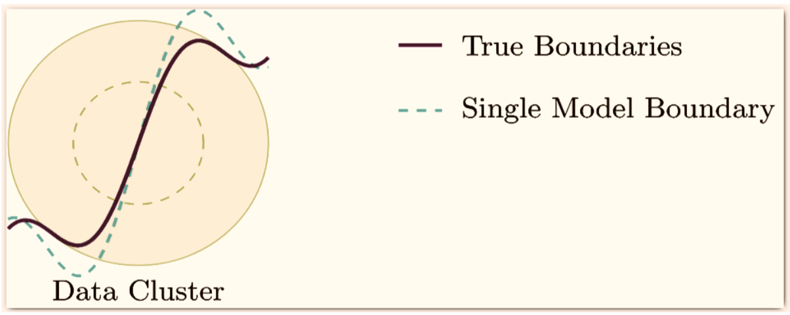
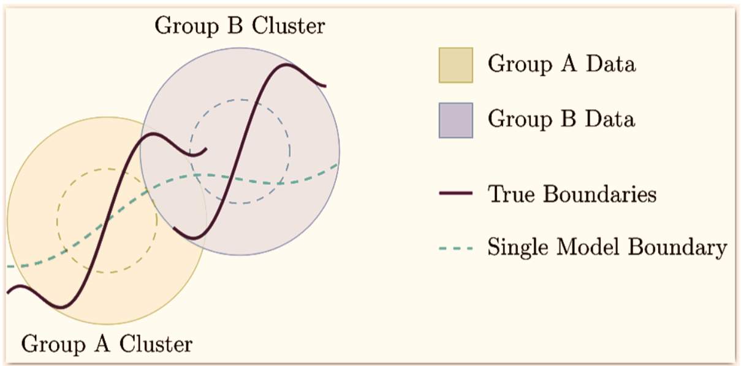
Enter Dynamic Logistic Ensembles
Single Logistic model on a simple dataset
A little complex dataset

Slide 5
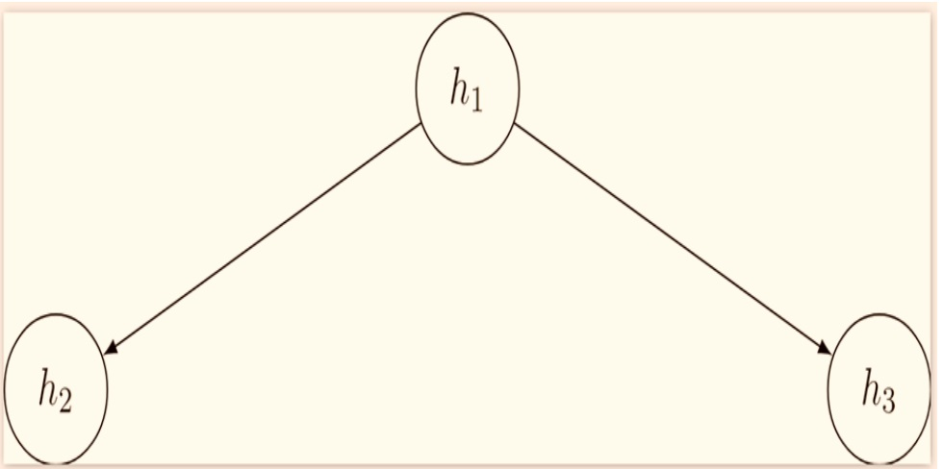
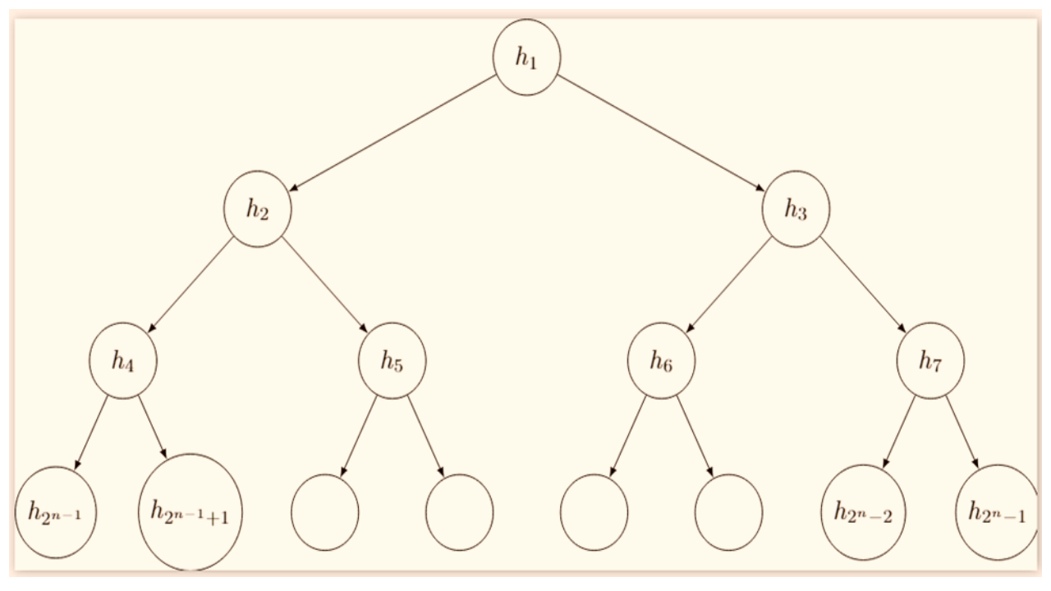
What Are They?
Two layered logistic ensemble
N-layered logistic ensemble
Imagine not just one logistic regression model, but a whole team of them, arranged in layers. Each “layer” breaks the "confidence" to each branch, allowing the ensemble to better capture hidden patterns.
5

Slide 6

Understanding : Dynamic Logistic Ensembles
No Math Needed: Think of it like adjusting a camera’s focus. A single lens might be blurry, but adding layers of lenses, each tuned to see a bit differently, creates a sharper, clearer picture.
The Result: We keep the simplicity and interpretability of logistic regression, but now it’s “supercharged” with better accuracy and the ability to understand complex data.
6

Slide 7
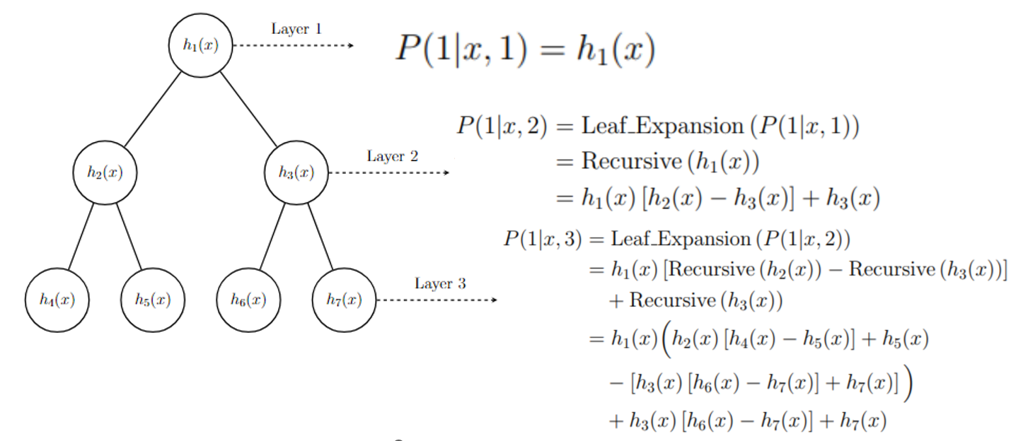
Compute efficient
Introducing recursive probability calculations in logistic ensembles
Generalization
Recursive rules applied to n-layer ensembles
Enables modeling complex decision boundaries while maintaining interpretability

Slide 8
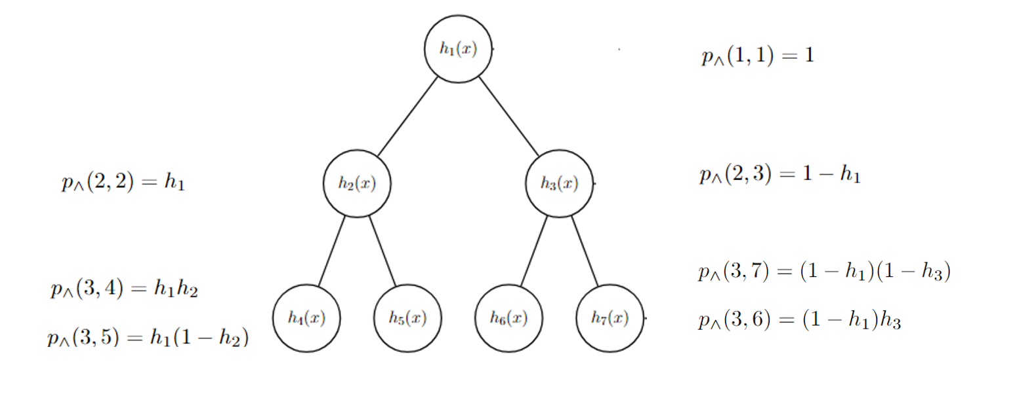
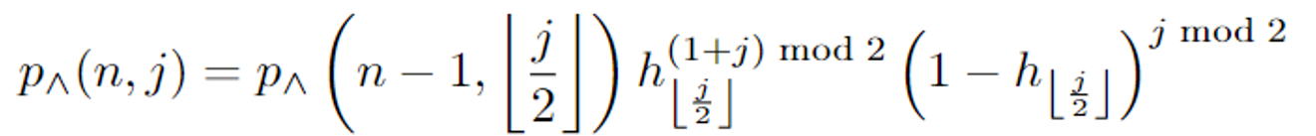
The ensemble cost comes from the maximum likelihood over ensemble probabilities.
One of the simple recursive path probability calculations in logistic ensembles to help compute the gradients
Generalization
Recursive rules applied to n-layer ensembles
Enables modeling complex decision boundaries while maintaining interpretability

Slide 9
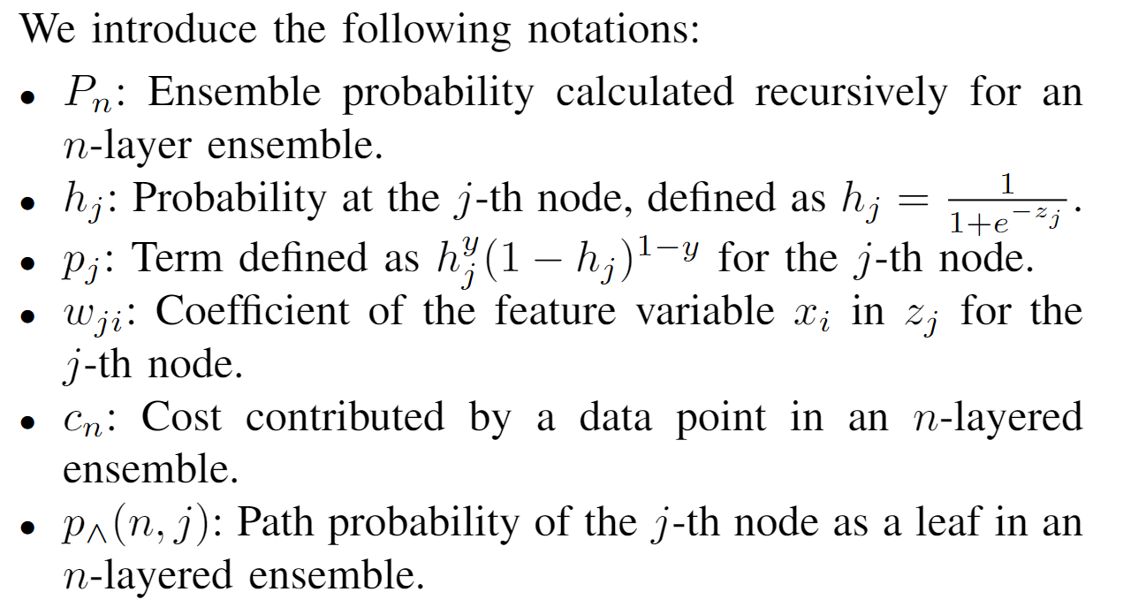
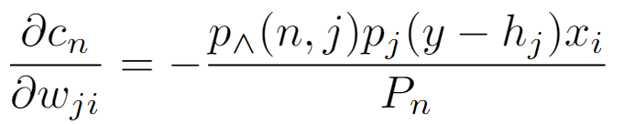
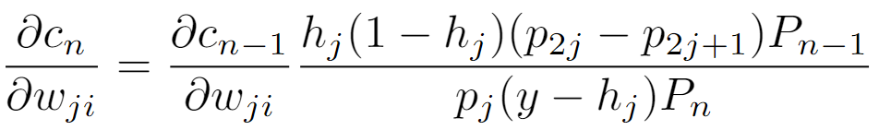
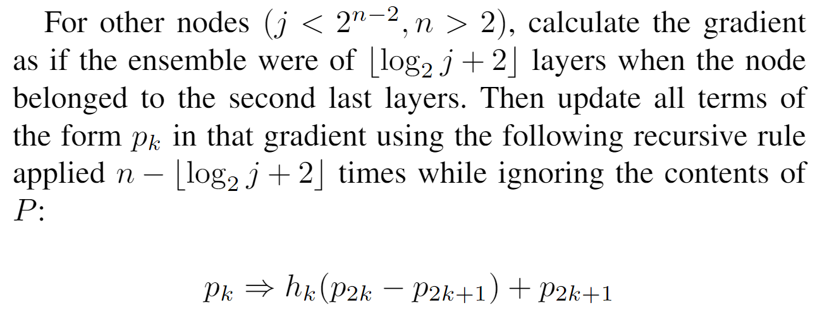
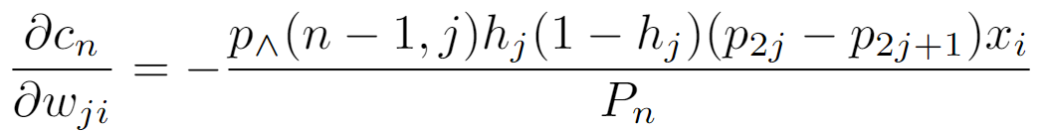
Generalized Gradient
For leaf nodes i.e. $j≥2^{n−1}$
For Parents of leafs i.e. $2^{n−2}≤j<2^{n−1}$
or

Slide 10
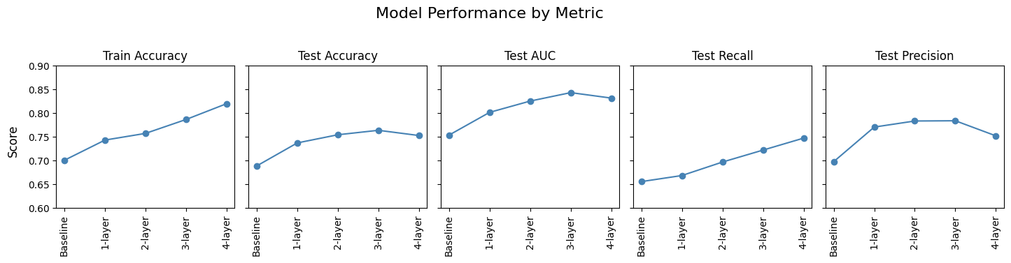
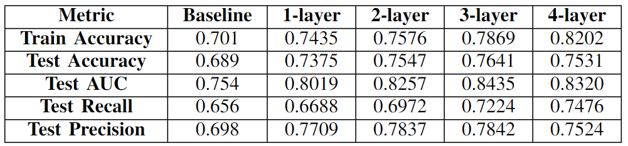

Slide 11
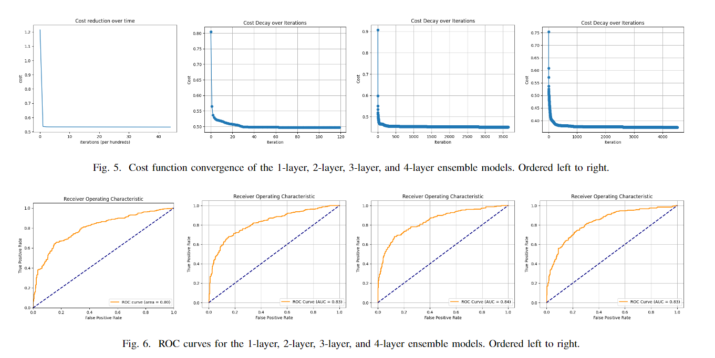

Slide 12

Transforming Healthcare
More Accurate Diagnosis
Doctors get clearer signals about who might have a certain condition, catching diseases earlier.
Personalized Treatment
Resource Management
Predict who benefits most from a specific treatment, so patients get exactly what they need.
Better predict hospital admissions, helping clinics and hospitals plan staff and equipment ahead of time.

Slide 13
Transforming Industry
Smarter Fraud Detection
Spot suspicious transactions faster and more accurately.
Customer Insights
Financial Risk Management
Know which customers might switch to competitors and offer them incentives before they do.
More reliably predict loan defaults or market shifts, guiding safer investments.

Slide 14



Why This Matters to Everyone?
Faster Decisions:
Because it’s still logistic regression at its core, it’s quicker and more transparent than black-box models like complex neural networks—crucial when decisions need to be made fast.
Scaling Up:
From a small clinic to a global bank, dynamic logistic ensembles can scale, making a real-world impact everywhere.
Global Good:
Improving healthcare predictions can save lives. Enhancing fraud detection saves money. Together, these improvements add up, creating a massive ripple effect on well-being and economic stability worldwide

Slide 15

The Future and Your Takeaway
Beyond Just a Tool: This isn’t just another model; it’s a step forward in how we think about problem-solving with data.
By focusing on one solid, familiar tool (logistic regression) and making it smarter, we unlock better decisions in medicine, finance, retail, and beyond—without losing the trust and clarity we need.
Next Steps: Adopting dynamic logistic ensembles means investing in research, adapting infrastructure, and embracing this new generation of intelligent models. The payoff? More accurate predictions, better decisions, and improvements that resonate around the globe.

Slide 16
“What would the world look like if every prediction we made—from diagnosing a patient to approving a loan—was just that bit clearer, smarter, and more trustworthy?”

Slide 17
Thank you
Paper Link:
https://arxiv.org/html/2411.18649v1#:~:text=The%20dynamic%20ensemble%20model%20is,models%20in%20a%20tree%20structure.
Github Link:
https://github.com/ensemble-art/Dynamic-Logistic-Ensembles/tree/main

